Slide 1
4. Data Preprocessing & Feature Engineering
Avanade ASG Data Science Bootcamp

Slide 2
Agenda
14:00 – 15:15
15:15 – 15:30
15:30 – 16:00
16:00- 17:00
Theory part
4.1_data_preprocessing_&_feature_engineering.pptx
Break
Demo (Regression dataset preprocessing)
Regression_dataset_preprocessing.ipynb
Lab (Classification dataset preprocessing)
Assignment_classification_preprocessing.ipynb
Solution_Classification_preprocessing.ipynb
You will find all the materials at the Github repository:
datascience-bootcamp/content/04_data_preprocessing_&_feature_engineering/
Notes:
Blue: need Azure

Slide 3
Preprocessing Introduction II:
In an „Ideal“ scenario, a typical ML process would look like:
INPUT
(Raw Data)
ML Model Building
OUTPUT
(Model Predictions)
However, in real world scenarios, the raw data is in very low quality and must be preprocessed:
Preprocessing = processing raw data prior to ML model building to improve data quality
INPUT
(Raw Data)
Preprocessing
ML Model Building
OUTPUT
(Model Predictions)

Slide 4
Preprocessing Introduction I:
The following dataset is the input of a regression model to predict the car prices, based on other features.
However at its current state, the ML algorithm would immediately run into errors.
In addition, we can perform other actions to improve the quality of this dataset.
What problems do you see in this dataset?
ID | Brand | size | gear | Door_nr | fueltype | year | km | Nr_owners | ISNEW | price
1 | Ford | S | Manual | four | Gas | 2022 | 0 | 0 | Y | 20 k
2 | BMW | L | Auto | four | Gas | 2022 | 0 | 0 | Y | 30.4 k
3 | BMW | L | Auto |  | Benzin | 2022 | 0 | 0 | Y | 26.3 k
4 | VW | L | Manual | two | Benzin | 2010 | 41,456 | 2 | N | 19 k
5 | Opel | M | Manual | two | Electric |  | 45,100 | 5 | N | 12 k
6 | Mazda | M | Auto | four | Benzin | 2005 | 5,854 | 1 | N | 18.45 k
7 | Mazda | M | Manual |  | Benzin | 2019 | 62,741 |  | N | 12 k
8 | Mazda | S | Manual | four | Benzin | 2014 |  | 4 | N | 16.9 k
9 | VW |  | Manual | four | Benzin | 2022 | 0 | 0 | Y | 17.4 k
10 | Ford | L | Manual | four | Electric | 1950 | 400,000 | 7 | N | 2 k
11 | VW |  | Auto | six | Benzin | 2016 | 13,400 |  | N | 69.9 k

Slide 5
Preprocessing Introduction III:
We can broadly categorize different preprocessing actions into 3 categories:
Data cleaning (dealing with missing or corrupt data)
Feature engineering (creating new features out of the original ones)
Feature selection (reducing the dimensionality of dataset by selecting a subset of features)
Today, we will discuss the following topics:
Missing Data Imputation
Complete Case Analysis
Mean or Median Imputation
Frequent Category Imputation
Categorical Variable Encoding
Label Encoding
Count or frequency Encoding
One Hot Encoding
Outlier Handling
Outlier trimming
Outlier Capping
Feature Scaling
Standardization
Min-Max Scaling
Feature selection
Dropping Constant Features
Correlation-based Feature Selection

Slide 6

Loading data with Pandas
Pandas is a library written for Python for data manipulation and analysis.
We first need to import this library
We then define a dataframe (df) to load the data (csv, xlsx, JSON, …) from a source (disk).
Dataframe = a two-dimensional (tabular) representation of data which is created in order to perform manupulations on the data.
Accessing a column
Filtering a column for a particular value
After all manipulations performed on the dataframe, we save it on the disk
import pandas as pd
df= pd.read_csv(‘./raw/raw_data.csv', sep= "," , encoding= "utf-8")
df["column1"]
df = df[df["column1"]= "value1"]
df.to_csv("./processed/processed_data.csv", sep = ",", encoding= "utf-8")

Slide 7
1. Missing Data Imputation:
It happens very often that the dataset contains missing (empty, null) values
This can happen because of
Lost or forgotten data (example: data was not provided in a survey)
Value of variable does not exist (example: division by zero)
Validation column generates NA (example: wrong email format, ...)
Imputation = replacing missing data with statistical estimates of them
Different imputation methods can be categorized into methods for:
Numerical variables: - Complete Case Analysis (CCA) - Mean/Median Imputation
Categorical variables: - Frequent category imputation - Adding a „missing“ category

Slide 8
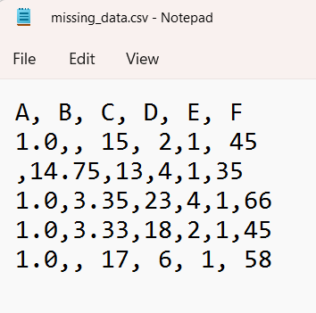
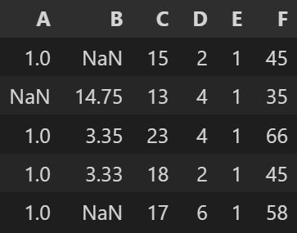
Missing values in Pandas
In Python missing values are represented by:
None: is a Python singleton object that is often used for missing data in Python code.
In Pandas missing values are represented by:
NaN : (Not a Number) is a special value recognized by all systems that use the IEEE standard.
df= pd.read_csv(‘missing_data.csv’)

Slide 9
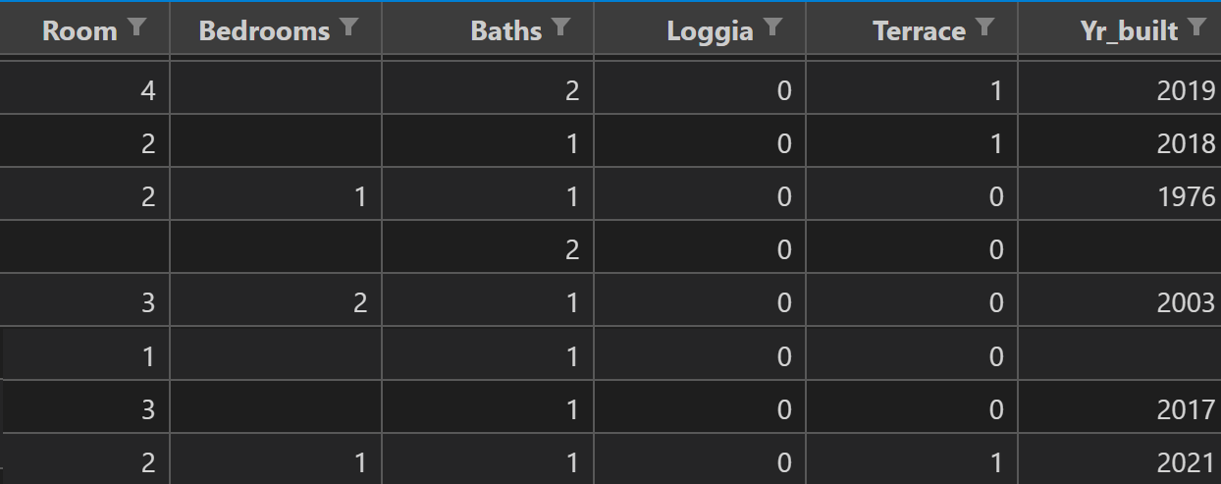
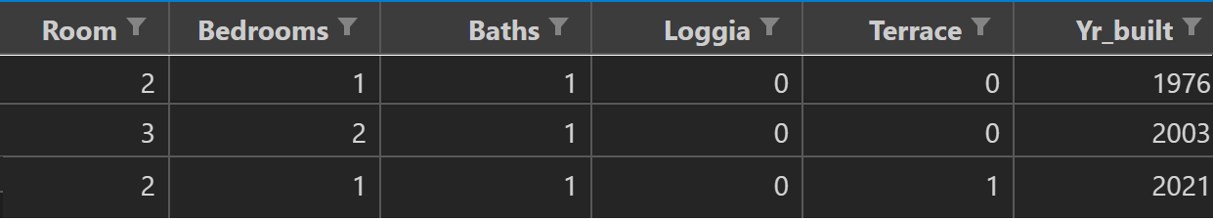
CCA (Complete Case Analysis) - I
CCA amounts to dropping the entire records where values in any of the features are missing
When use it?
If the missing data is distributed completely randomly
If not more than 5% of dataset has missing values
Disadvantages
Destroys the original variable distribution
Destroys the covariance with the remaining variables of the dataset

Slide 10
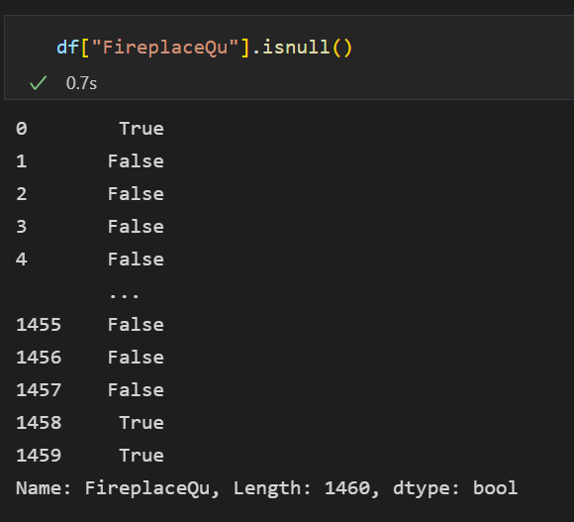
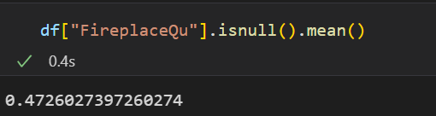
CCA (Complete Case Analysis) - II
How to detect null values in Pandas?
Calculate the percentage of the null values
df["column"].isnull() → boolean indicating if a column contains null values
df["column"].isnull().mean()

Slide 11
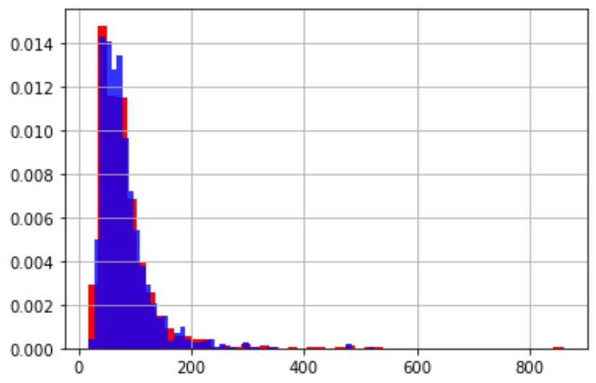
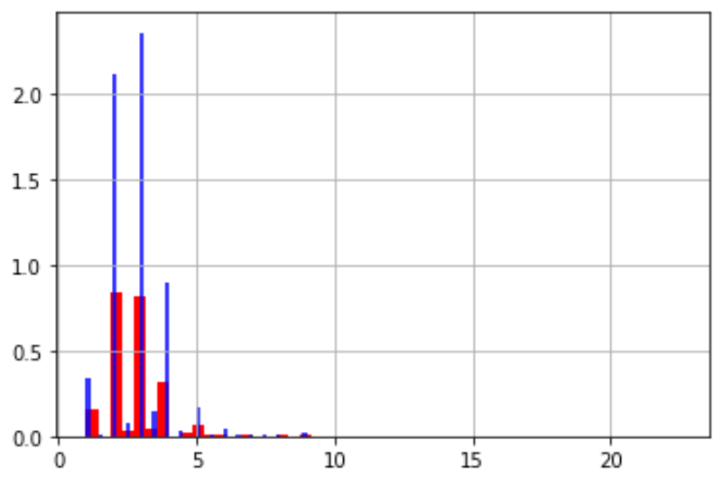
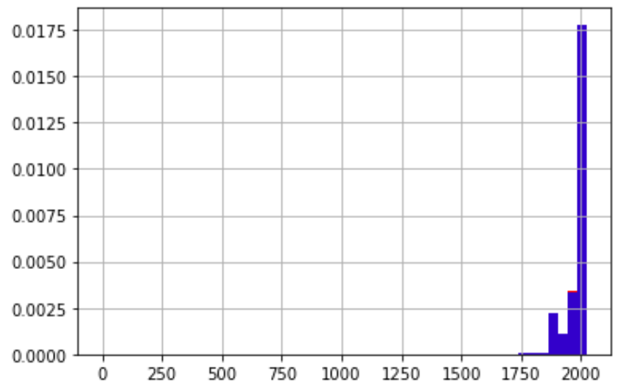
CCA (Complete Case Analysis) – III
We want to create a list of columns with less than 5% null values
It outputs a list of all columns in df
dropping records which contain a null value
Plot the distribution of these columns before and after CCA imputation
df.columns
cca_cols = [col for col in df.columns if df[col].isnull().mean() <0.5]
df= df.dropna(subset=cca_cols, axis=0)

Slide 12
Mean or Median Imputation - I
Mean or Median Imputation amounts to replacing all missing values by mean or median of that variable
1
1
2
1
1
1
Mean of Bedrooms = (1+2+1)/3 = 1.33 → 1
Median of Room = 2
Assumptions:
Data is missing completely at random
The missing values look like the majority of the values (mean or median)

Slide 13
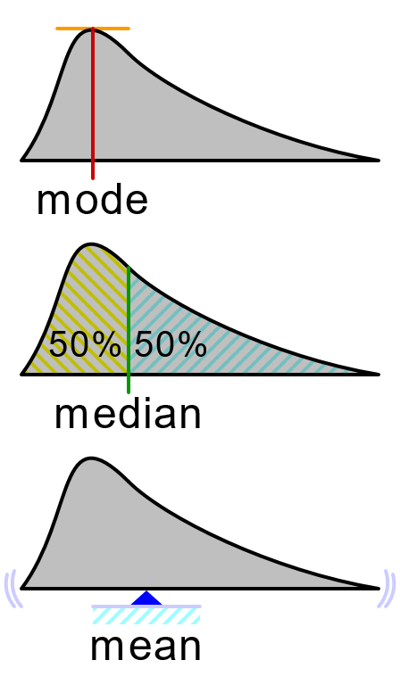
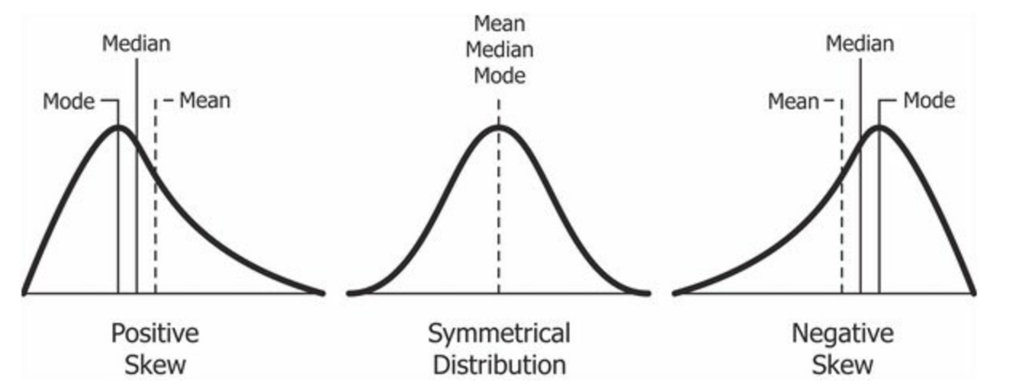
Mean or Median Imputation - II
Recap of Mean, Median, Mode
Consider the sample dataset = [ 1, 2, 2, 3, 4, 7, 9 ]
Median = value separating the higher half from the lower half → 3
Mean = arithmetic average → (1+2+2+3+4+7+9)/7 = 4
Mode = Most frequent value → 2
When to use mean or median?
Use mean imputation for symmetric distributions
Use median imputation for skewed distributions (for skewed distributions, median is a better representation of the majority of values)
https://en.wikipedia.org/wiki/Mode_(statistics)#/media/File:Visualisation_mode_median_mean.svg

Slide 14
Mean or Median Imputation - II
Replacing the null values of a column with a new_value:
To avoid overfitting, mean/median should be calculated only using the train set.
The value calculated should be used to replace missing values in both train and test sets
df["column"].fillna(new_value)
column_mean = X_train["column"].mean()
column_median = X_train["column"].median()
X_train["column"] = X_train["column"].fillna(column_mean) X_test["column"] = X_test["column"].fillna(column_mean)

Slide 15
Frequent Category Imputation (Mode Imputation)- I
Frequent Category Imputation amounts to replacing all missing values by the most frequent value (mode) of that variable
car
BMW
BMW
VW
Mazda
BMW
Audi
BMW
Audi
car
BMW
BMW
VW
BMW
Mazda
BMW
BMW
Audi
BMW
Audi
When use it?
If the missing data is distributed completely randomly
(the missing value looks like the majority of the observations)
If not more than 5% of dataset has missing values
Disadvantages:
Overrepresentation of the most frequent category (in case of a high fraction of missing values)

Slide 16
Frequent Category Imputation (Mode Imputation)- III
To avoid overfitting, mean/median should be calculated only using the train set.
The value calculated should be used to replace missing values in both train and test sets
Replacing null values with the mode in X_train and X_test
column_mode = df["column"].mode()
X_train["column"].fillna(column_mode , inplace=True)
X_test["column"].fillna(column_mode , inplace=True)

Slide 17
Adding a „Missing“ category- I
This Imputation method amounts to creating a new category called „Missing“ and replacing all null values by this new label
car
BMW
BMW
VW
Mazda
BMW
Audi
BMW
Audi
car
BMW
BMW
VW
Missing
Mazda
BMW
Missing
Audi
BMW
Audi
When use it?
There is no assumption on the data so can be always used for categorical variables
Use when the percentage of the missing data is high

Slide 18
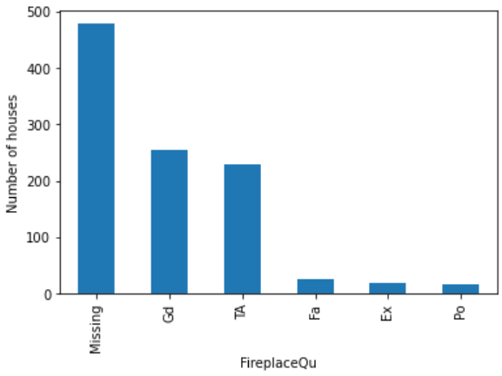
Adding a "Missing" category- II
Replacing missing values with "Missing" in X_train and X_test
X_train["column"].fillna("Missing" , inplace=True)
X_test["column"].fillna("Missing" , inplace=True)

Slide 19
2. Categorical encoding:
Some of the features of our raw dataset may be of the string type (not numbers) which appear in a number of categories.
They are called categorical variables
Example1: binary → (Yes, No) or (True, False)
Example2: size → small, medium, large.
Example3: color → red, blue, green, yellow, brown, black.
We cannot feed such variables directly to an ML algorithm, because ML algorithms use numerical variables.
Encoding = process of converting categorical data into integers.
We will explore different methods of categorical encoding including:
Label Encoding
Count or frequency Encoding
One Hot Encoding

Slide 20
Label Encoding - I
This encoding method amounts to assigning a number to each category
Color
Blue
Green
Green
Red
Yellow
Blue
Color
1
2
2
3
4
1
Advantages:
Does not enlarge the feature space
Straightforward implementation
Drawbacks:
There might be categories in the test set which are not encoded automatically

Slide 21
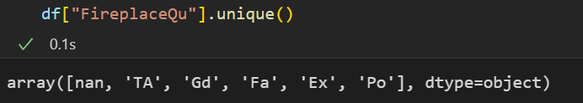
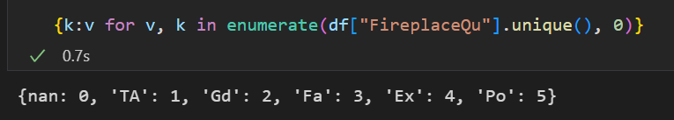
Label Encoding (using Pandas) - II
First explore how many distinct categories are there in the desired column
This will result in an array of distict categories:
X_train["column"].unique()
We now create a dictionary which assigNs a number to each category
dict= {k:v for v, k in enumerate(X_train["column"].unique(), 0)}
use the map() method and apply it to the train and test sets
X_train["column"] = X_train["column"].map(dict)
X_test["column"] = X_test["column"].map(dict)

Slide 22
Label Encoding (using Sklearn) - III
The same encoding can be done using Scikit-learn
We need the LabelEncoder transformer
from sklearn.preprocessing import LabelEncoder
We now create a label encoder and fit the train data to it
le = LabelEncoder()
le.fit(X_train["column"])
To implement the encoding, we transform the X_train and X_test using the transform method
X_train["column"] = le.transform(X_train["column"])
X_test["column"] = le.transform(X_test["column"])

Slide 23
Count or frequency Encoding - I
Replace each category with the count (or percentage of occurance) of each category in the dataset.
Color
Blue
Green
Green
Red
Green
Blue
Yellow
Color
2
3
3
1
3
2
1
Color
0.28
0.43
0.43
0.14
0.43
0.28
0.14
Assumption
The number of observations for each category influences the prediction of the target.
Advantage:
Does not enlarge the feature space
Disadvantage:
Not suitable for linear models (relationship btwn lables and target might not be linear)

Slide 24
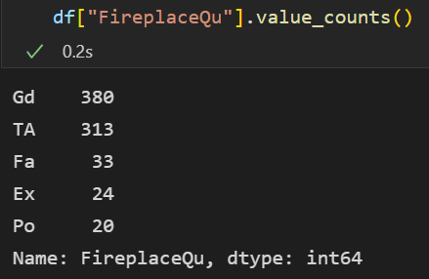
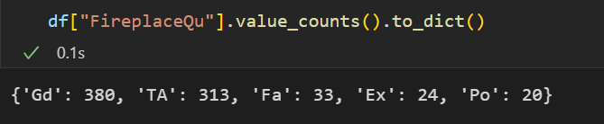
Count or frequency Encoding (using Pandas) - II
First explore the value counts of each category in the column using value_counts()
value_counts() returns a Pandas Series but we need to convert it to a dictionary using to_dict()
X_train["column"].value_counts()
dict= X_train["column"].value_counts().to_dict()
To implement it we use the map() method and apply it to the train and test sets
X_train["column"] = X_train["column"].map(dict)
X_test["column"] = X_test["column"].map(dict)

Slide 25
One Hot Encoding- I
This encoding method amounts to creating new columns for each label and filling their values with a boolean 1/0 indicating the presence/absence of that label.
Color
Blue
Green
Green
Red
Yellow
Blue
Blue | Green | Red | Yellow
1 | 0 | 0 | 0
0 | 1 | 0 | 0
0 | 1 | 0 | 0
0 | 0 | 1 | 0
0 | 0 | 0 | 1
1 | 0 | 0 | 0
Advantages
No assumptions about the categories or how they are distributed
Suitable for linear models (because variables are encoded with just two values)
Disadvantages
Enlarges the field space

Slide 26
One Hot Encoding - II
OneHot Encoding into k variables (k = number of distinct categories)
Color
Blue
Green
Green
Red
Yellow
Blue
Blue | Green | Red | Yellow
1 | 0 | 0 | 0
0 | 1 | 0 | 0
0 | 1 | 0 | 0
0 | 0 | 1 | 0
0 | 0 | 0 | 1
1 | 0 | 0 | 0
Blue = (1,0,0,0)
Green = (0,1,0,0)
Red = (0,0,1,0)
Yellow = (0,0,0,1)
OneHot Encoding into k-1 variables (encoding of the k-th category is redundant!)
Color
Blue
Green
Green
Red
Yellow
Blue
Blue | Green | Red
1 | 0 | 0
0 | 1 | 0
0 | 1 | 0
0 | 0 | 1
0 | 0 | 0
1 | 0 | 0
Blue = (1,0,0)
Green = (0,1,0)
Red = (0,0,1)
Yellow = (0,0,0)
Advantage: (k-1) OHE avoids training redundant data
Drawback: keeping all categories could be useful in interpreting the model

Slide 27
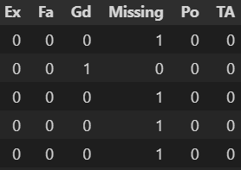
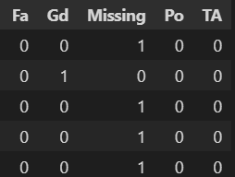
One Hot Encoding (using Pandas)- II
OneHot Encoding into k variables
pd.get_dummies(X_train["column"] )
OneHot Encoding into k-1 variables
pd.get_dummies(X_train["column"], drop_first = True )
Advantage: get_dummies returns a Pandas dataframe
Drawback: it could be that some of the categories do not appear in the train or test sets! Then we will get different number of features for the train and test sets!

Slide 28

One Hot Encoding- III (Using Scikit-learn)
OneHot Encoding into k variables
from sklearn.preprocessing import OneHotEncoder
encoder = OneHotEncoder(sparse= False, handle_unknown='ignore')
encoder.fit(X_train['column'])
transformed = encoder.transform(X_train['column'])
df_OHE = pd.DataFrame(transformed)
Sparse=False → a Numpy array will be returned (instead of a sparse matrix)
handle_unknown='ignore‘ → If there are categories in the test set that are not present in the training set , the resulting one-hot encoded columns for this feature will be all zeros.
Advantage: it returns the same number of dummy features for train and test sets
Drawbacks: it returns a Numpy array (not a pandas dataframe) → does not keep the name of variables

Slide 29
3. Handling Outliers:
In statistics, an outlier is a data point that differs significantly from other observations.
Outliers influence the performance of ML algorithms
Outliers may lead to overfitting
outlier
Remove outlier
Different methods for handling outliers:
Outlier trimming (dropping the whole record)
Outlier capping (censoring by min/max values)

Slide 30
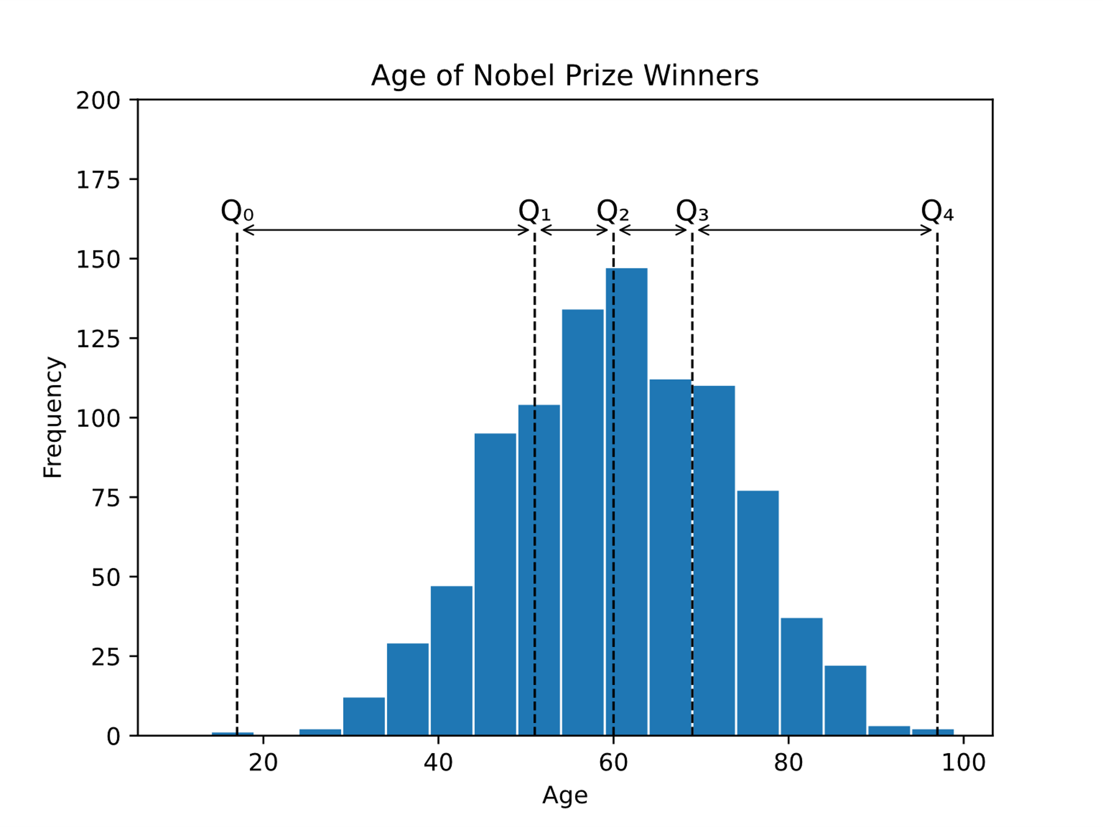
How to detect outliers I:
Recap of Quantiles:
The dataset can be devided into four Quartiles:
Q1: 25% of data lie below Q1
Q2: 50% of data lie below Q2
Q3: 75% of data lie below Q3
IQR = Q3 –Q1 (Inter Quartile Range): 50% of data lie within IQR
w3schools.com

Slide 31
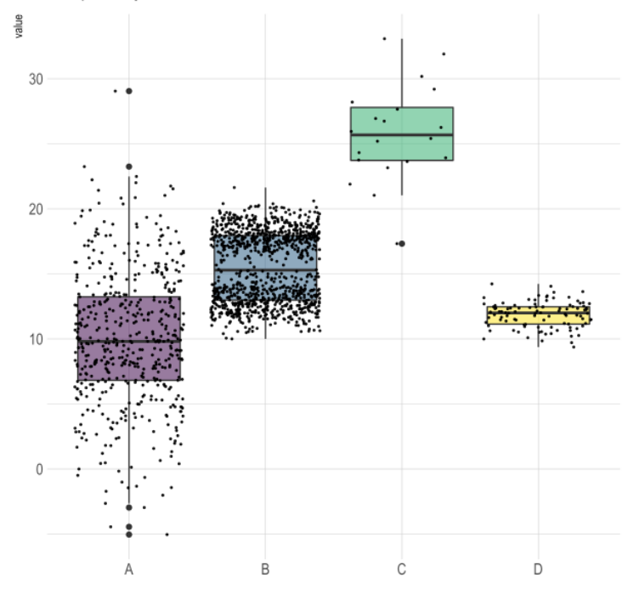
How to detect outliers II:
Recap of Boxplot
Q3
Median
Mean
Q1
IQR
r-graph-gallery.com

Slide 32
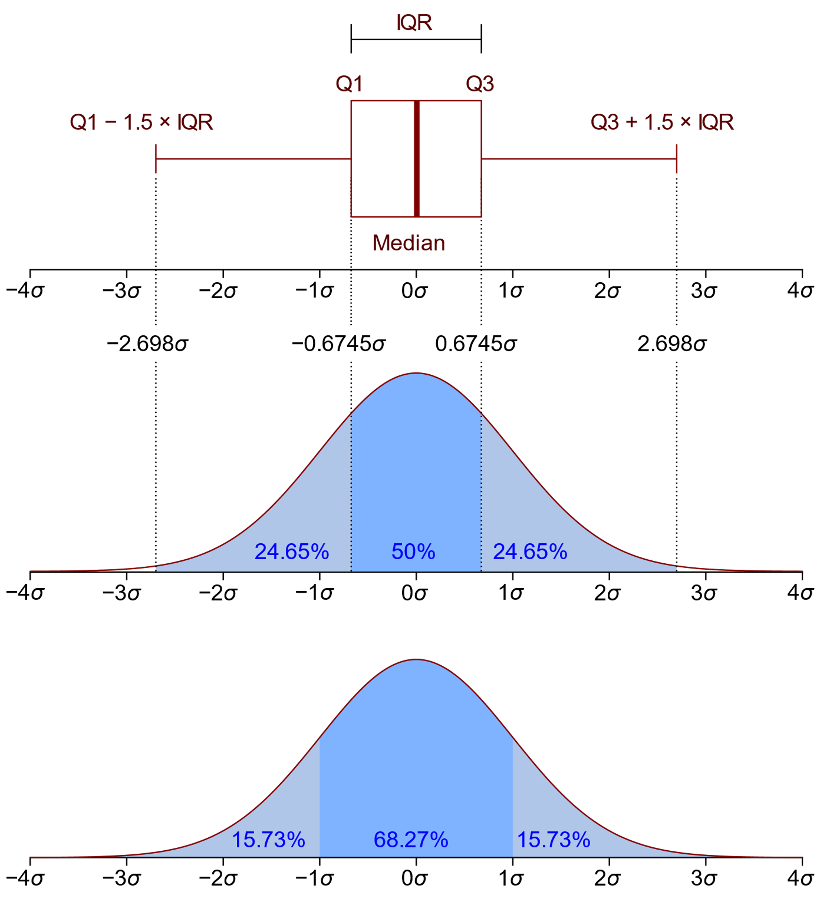
How to detect outliers III:
Normal distribution (Mean = median = mode)
Two ways to define outliers:
Outliers lie outside [-3σ, +3σ]
Outliers lie outside [Q1-1.5 * IQR, Q3+1.5 * IQR]
99.73% of data lie within [-3σ, +3σ]
IQR = Q3 –Q1 (Inter Quartile Range)
25% of data lie below Q1
75% of data lie below Q3
Skewed distribution (Mean ≠ median ≠ mode)
mean is shifted "further into the tail" of a distribution than the median

Slide 33
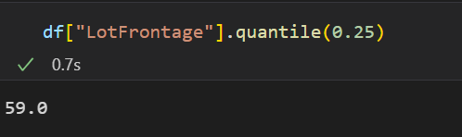
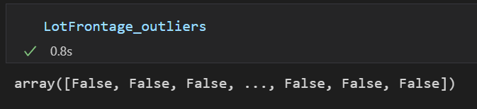
Detecting outliers with Pandas
The Pandas method quantile(α), with 0≤α≤1 calculates the α-th quantile of a column values
Using quantile(), we can define IQR, lower_boundary and upper_boundary for each column
Create a list with boolean values indicating whether each record in the considered column is an outlier (True) or not (False)
df["column"].quantile(α)
Col_IQR = df["column"].quantile(0.75) - df["column"].quantile(0.25)
col_lower_boundary = df["column"].quantile(0.25) - (col_IQR * 1.5)
col_upper_boundary = df["column"].quantile(0.75) + (col_IQR * 1.5)
col_outliers = np.where(df["column"] > col_upper_limit, True,
np.where(df["column"] < col_lower_limit, True, False))

Slide 34
Outlier trimming
Outlier trimming = Dropping all the records which include an outlier
Drop all the records with a True value in the above array
col_outliers = np.where(X_train["column"] > col_upper_limit, True,
np.where(X_train["column"] < col_lower_limit, True, False))
X_train= X_train.loc[~(col_outliers), ]
y_train= y_train.loc[~(col_outliers), ]
Advantages
Fast and straightforward implementation
Disadvantages
Dropping a big part of the data set (if many features have outliers)

Slide 35
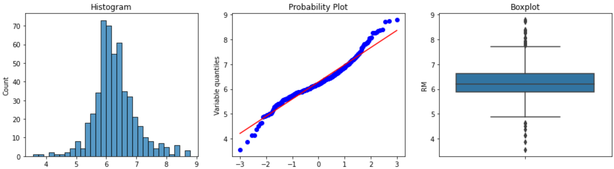
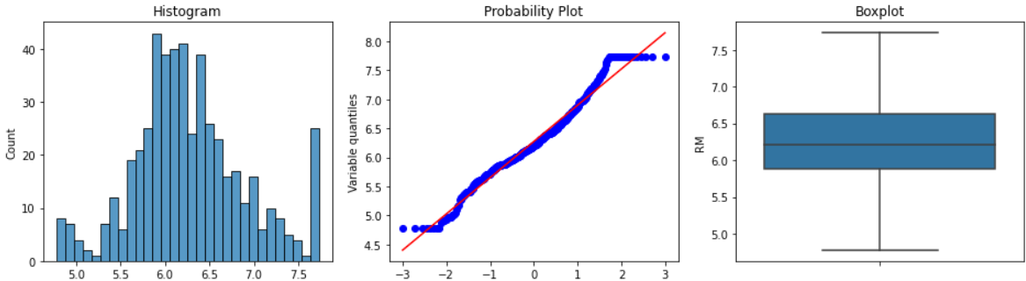
Outlier Capping
In this method, we replace the outliers at both tails (or one of the tails) by the maximum and minimum limits, respectively .
col_outliers = np.where(X_train["column"] > col_upper_limit, col_upper_limit,
np.where(X_train["column"] < col_lower_limit, col_lower_limit, df["column"]))
Before capping
After capping
Advantages
Fast and straightforward implementation
Does not reduce the dataset size (no record is removed)
Disadvantages
Distorts the variables distributions

Slide 36
4. Feature Scaling
WHY Feature scaling? The magnitude of the features is important in training ML model:
values with larger magnitude may dominant the ones with smaller magnitude while learning
faster convergence of gradient descent when features are on similar scales
Tree-based algorithms are insensitive to feature magnitudes
WHAT is Feature scaling?
A method to normalize the magnitude of features.
For example: to a range between 0 and 1.
It is achieved via a scaling function: X_scaled = f(X)
Different feature scaling methods:
Standardization
Min-Max Scaling

Slide 37
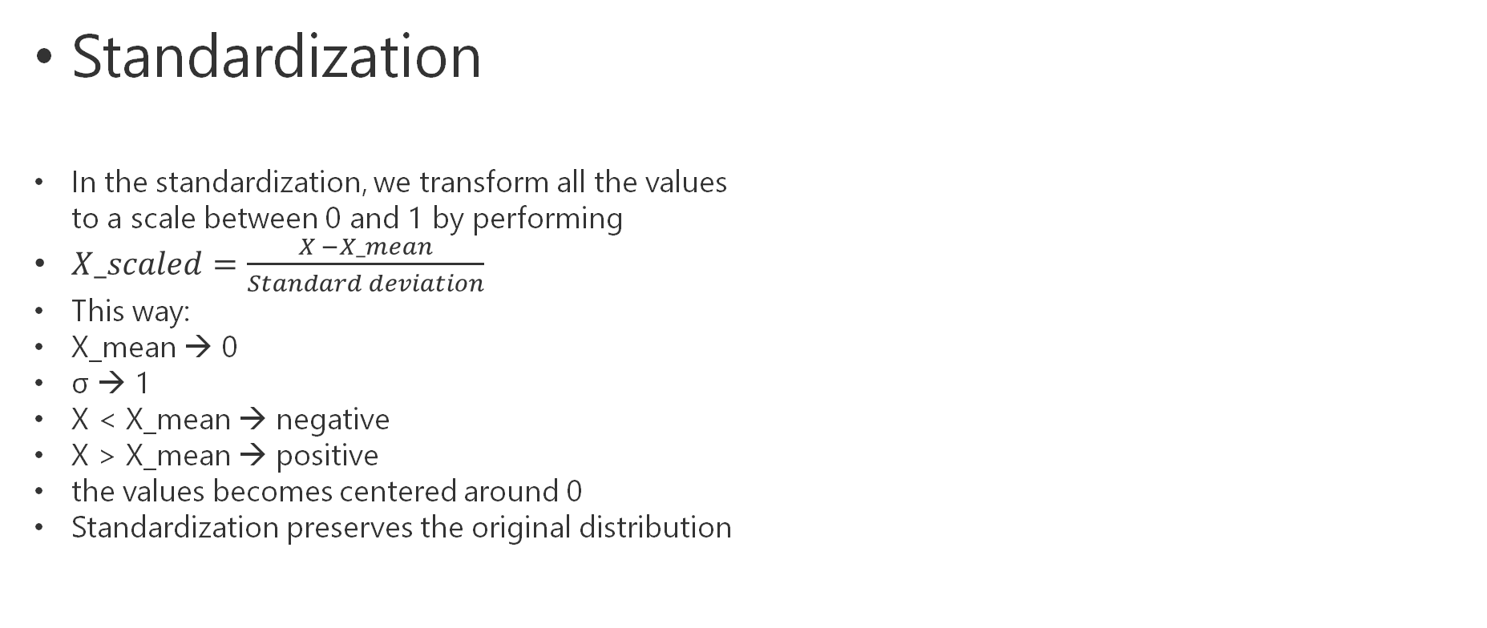
Standardization
In the standardization, we transform all the values to a scale between 0 and 1 by performing
$X_scaled=\frac{X −X_mean}{Standard deviation}$
This way:
X_mean → 0
σ → 1
X < X_mean → negative
X > X_mean → positive
the values becomes centered around 0
Standardization preserves the original distribution
X
70
43
6
29
130
193
75
64
112
57
X_scaled
-0.15
-0.67
-1.39
-0.94
1.01
2.23
-0.05
-0.27
0.66
-0.40
X_mean = 78
σ = 54

Slide 38
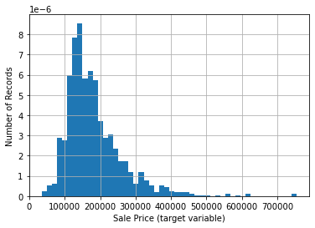
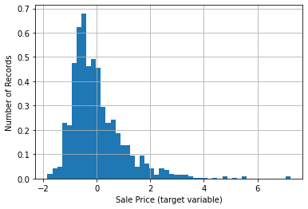
Standardization-II
Use the StandardScalar of Scikit-Learn
from sklearn.preprocessing import StandardScaler
scaler = StandardScaler()
scaler.fit(X_train)
X_train_scaled = scaler.transform(X_train)
X_test_scaled = scaler.transform(X_test)
Before scaling
After scaling

Slide 39
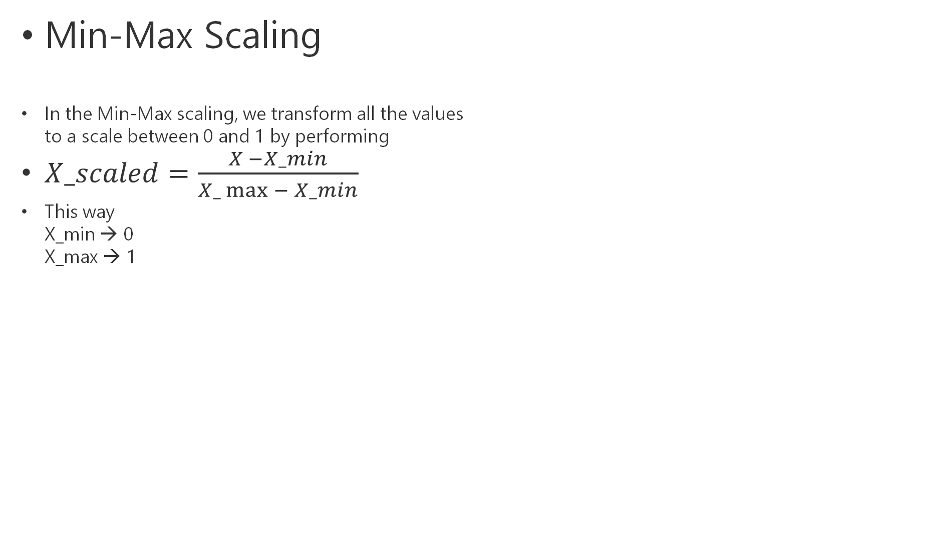
Min-Max Scaling
In the Min-Max scaling, we transform all the values to a scale between 0 and 1 by performing
$X_scaled=\frac{X −X_min}{X_\max{− X_min}}$
This way X_min → 0 X_max → 1
X
70
43
6
29
130
193
75
64
112
57
X_scaled
0.34
0.19
0
0.12
0.66
1
0.36
0.31
0.56
0.27
X_min = 6
X_max = 193
X_max – X_min = 187

Slide 40
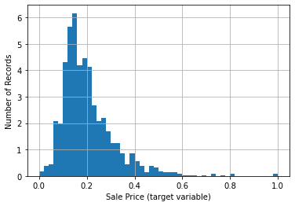
Min-Max Scaling -II
Use the MinMaxScalar of Scikit-Learn
from sklearn.preprocessing import MinMaxScaler
scaler = MinMaxScaler()
scaler.fit(X_train)
X_train_scaled = scaler.transform(X_train)
X_test_scaled = scaler.transform(X_test)
Before scaling
After scaling

Slide 41
5. Feature Selection
Feature selection is the process of finding a subset of features which are the most predictive ones for the chosen ML algorithm.
WHY Feature selection?
Makes models simpler to understand and interpret (a model with 10 features is more understandable than with 100 features)
Reduces training time
Reduces overfitting
Avoids data redundancy

Slide 42
How data redundancy can occur in a dataset?
Constant features
Take only one value in the entire dataset → have no predictive power
Quasi-constant features
Take only one value in more than 99% of the dataset → usually no predictive power
Duplicated features
Two or more identical features with different names
Correlated variables
Two or more features which are highly correlated → only one of them is enough to keep

Slide 43
Different feature selection methods:
Filter methods
Does not depend on the ML model to be performed on the features (Model agnostic)
Select a subset of features based on the characteristics of each individual feature separately
Quick first step in removing unnecessary features and reducing the size of the dataset
Wrapper methods
Depend on the ML model (Not model agnostic)
Select a subset of features by evaluating a group of features and their interactions
They consider all possible feature subsets, run the desired ML model on these subsets and then decide which subset is the best.
Computationally expensive → not practical
Embedded methods
Depends on the ML model (Not model agnostic)
Embedded methods combine the advantages of filter and wrapper methods. The feature selection algorithm is integrated as part of the learning algorithm
Examples: Lasso (it shrinks many features to zero or almost near to zero.)
Here we focus only on the filter methods.

Slide 44
Dropping constant features
Create a list of constant features
Drop the constant features on X_train and X_test
const_feat = [X for X in X_train.columns if X_train[X].nunique() == 1]
X_train.drop(labels=const_feat, axis=1, inplace= True)
X_test.drop(labels=const_feat, axis=1, inplace= True)

Slide 45
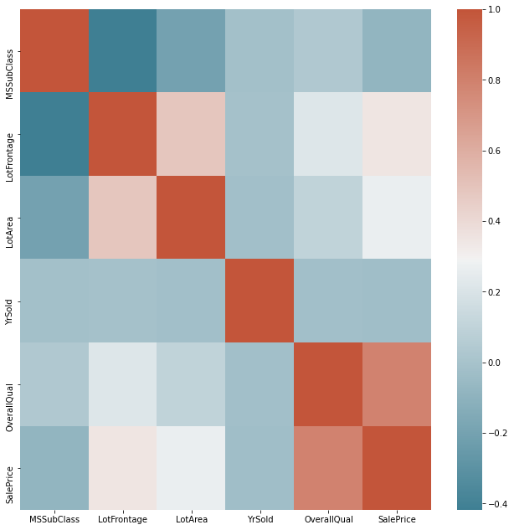
Correlation-based Feature Selection
We select the features that have the following properties:
High correlated features with the target
Low correlated features with other features
Visualize the correlation matrix of features
Create a set of correlated columns col_corr
Drop the correlated features in X_train and X_test
X_train.drop(labels=col_corr, axis=1, inplace=True)
X_test.drop(labels=col_corr, axis=1, inplace=True)

